Slide 1
Skills Bootcamp Classroom Rules
Be on time: Just like in a physical classroom, it's important to be punctual for your online class. Log in to the virtual classroom a few minutes before the class starts.
Turn Cameras on: In order to maximise your learning studies show that being able to see your peers and your tutor being able to see you can increase motivations and retention, therefore we ask to keep your cameras on.
Attend all classes: In order to be successful in your bootcamp studies you need to attend all live sessions, therefore you should prioritise and make time for these sessions.
Avoid distractions: Turn off your phone notifications, close any other unnecessary tabs, and focus solely on the class.
Participate actively: It's important to be an active participant in the class. Ask questions, answer questions, and participate in discussions.
Use proper language and tone: Use respectful language and tone when communicating with your classmates and instructor. Avoid using slang or inappropriate language.
Respect others' opinions: Be respectful of others' opinions, even if they differ from your own. Avoid making negative comments or attacking others.
Follow the instructor's guidelines: Follow the instructor's guidelines, such as submitting assignments on time.
Be polite: Be polite and respectful to everyone in the class, including the instructor, classmates, and guest speakers.
Dress appropriately: Even though you are not in a physical classroom, it's important to dress appropriately. Dress as if you were going to a face-to-face class.
Use appropriate technology: Ensure that you have the necessary equipment, such as a reliable internet connection, a microphone, and a webcam, and that they are in good working condition.

Slide 2
Software Developer Bootcamp
Unit 2 – Digital Processes and Services
Week 5C

Slide 3
Objectives
Following this session, you should be able to:
Understand the Core Principles and Phases of Agile and RAD Methodologies
Apply Agile or RAD Methodology in a Simulated Small Team Project
Document the Agile or RAD Process Utilised in the Small Team Project

Slide 4
Core Principles and Phases of Agile and RAD Methodologies

Slide 5

Agile Methodology
Agile is an iterative and incremental software development methodology
It is based on adaptive planning, evolutionary development, early delivery, and continuous improvement
Agile methodology focuses on customer satisfaction, rapid delivery, and flexibility

Slide 6

Core Principles of Agile
Individuals and interactions over processes and tools
Working software over comprehensive documentation
Customer collaboration over contract negotiation
Responding to change over following a plan

Slide 7

Agile Phases
Planning: Establishing the project scope, timeline, and budget
Analysis: Gathering requirements and analyzing the project
Design: Designing the architecture and user interface
Implementation: Developing the software and testing it

Slide 8

RAD Methodology
RAD is a software development methodology that focuses on rapid prototyping and iterative development
It is based on prototyping and iterative development, with minimal planning
RAD methodology focuses on customer satisfaction, rapid delivery, and flexibility

Slide 9

Core Principles of RAD
Iterative development over comprehensive planning
Prototyping over detailed design
User involvement over contract negotiation
Adaptive development over following a plan

Slide 10

RAD Phases
Planning: Establishing the project scope, timeline, and budget
Analysis: Gathering requirements and analyzing the project
Design: Designing the architecture and user interface
Implementation: Developing the software and testing it

Slide 11

Comparison of Agile and RAD
Agile: Pros - Adaptive and iterative development, customer satisfaction, rapid delivery, flexibility. Cons - Complexity, lack of documentation, lack of control.
RAD: Pros - Rapid prototyping, iterative development, user involvement, adaptive development. Cons - Lack of planning, lack of control, lack of documentation.

Slide 12

Conclusion
Agile and RAD are both effective software development methodologies
The best methodology for your project depends on your specific needs and goals
It is important to weigh the pros and cons of each methodology before making a decision

Slide 13
Apply Agile or RAD Methodology in a Simulated Small Team Project

Slide 14

What is Agile?
Agile is an iterative approach to software development that focuses on collaboration, customer feedback, and rapid delivery of working software.
It is based on the idea of continuous improvement and adaptation to changing requirements.

Slide 15

What is RAD?
RAD is a software development methodology that focuses on rapid prototyping and iterative development.
It is based on the idea of quickly creating a working prototype and then refining it based on customer feedback.

Slide 16

Benefits of Agile and RAD
Agile and RAD can help teams deliver working software faster and with higher quality.
They also help teams adapt to changing requirements and customer feedback more quickly.

Slide 17
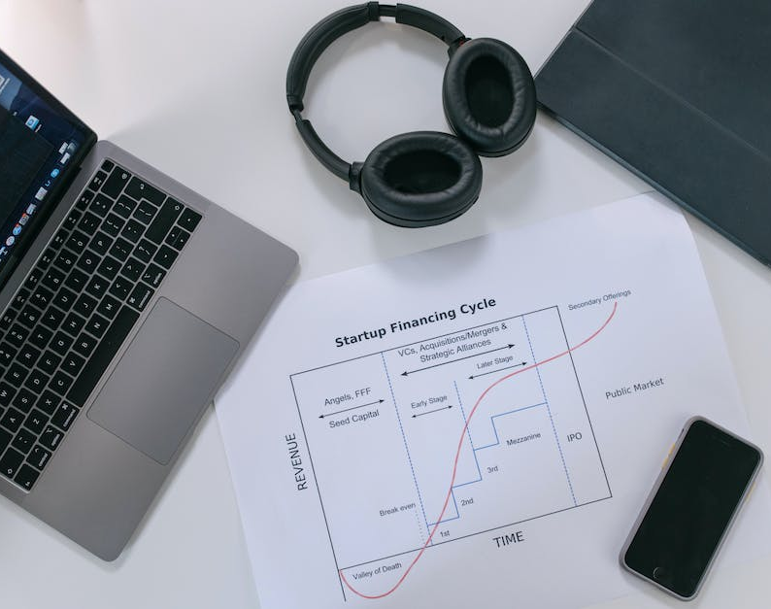
How to Apply Agile and RAD
To apply Agile and RAD in a small team project, teams should create an iterative process that includes:
- Defining the project scope and objectives
- Creating a timeline and milestones
- Developing a prototype and testing it
- Refining the prototype based on customer feedback
- Releasing the final product

Slide 18

Tools for Agile and RAD
There are many tools available to help teams apply Agile and RAD in a small team project.
These tools can help teams improve efficiency and collaboration, such as:
- Project management tools
- Collaboration tools
- Testing tools
- Documentation tools

Slide 19

Challenges of Agile and RAD
Agile and RAD can present some challenges for teams, such as:
- Managing change and adapting quickly to customer feedback
- Ensuring quality and accuracy of the final product
- Keeping the team focused and motivated
- Managing resources and timelines

Slide 20

Best Practices for Agile and RAD
To ensure success with Agile and RAD, teams should follow best practices such as:
- Establishing clear goals and objectives
- Creating a timeline and milestones
- Developing a prototype and testing it
- Refining the prototype based on customer feedback
- Releasing the final product

Slide 21

Conclusion
Agile and RAD can help teams deliver working software faster and with higher quality.
By following best practices and using the right tools, teams can ensure success with Agile and RAD in a small team project.

Slide 22
Agile or RAD Process Utilised in the Small Team Project

Slide 23

What is Agile or RAD Process?
Agile or RAD process is a project management methodology that focuses on delivering results quickly and efficiently.
It is based on the idea of breaking down a project into smaller, more manageable tasks and then adapting to changes as they arise.
The goal is to deliver the project on time and within budget.

Slide 24

Benefits of Agile or RAD Process
Agile or RAD process can help improve productivity and quality by allowing teams to focus on the most important tasks first.
It also allows teams to adapt to changes quickly and efficiently, which can help reduce costs and improve customer satisfaction.
Finally, it can help teams stay organized and on track, which can help reduce stress and improve morale.

Slide 25
Agile or RAD Process in Small Team Projects
Agile or RAD process can be especially beneficial for small team projects.
It allows teams to break down tasks into smaller, more manageable pieces, which can help reduce stress and improve efficiency.
It also allows teams to adapt to changes quickly and efficiently, which can help reduce costs and improve customer satisfaction.

Slide 26

Agile or RAD Process in Action
An example of Agile or RAD process in action is a team that is working on a website redesign.
The team can break down the project into smaller tasks, such as designing the homepage, creating the navigation, and coding the pages.
The team can then adapt to changes as they arise, such as customer feedback or changes in technology, which can help reduce costs and improve customer satisfaction.

Slide 27

Tools for Agile or RAD Process
There are a variety of tools available to help teams implement Agile or RAD process.
These tools can help teams stay organized and on track, which can help reduce stress and improve morale.
Tools such as project management software, task tracking software, and collaboration tools can help teams stay organized and on track.

Slide 28

Challenges of Agile or RAD Process
Agile or RAD process can present some challenges, such as difficulty in managing multiple tasks and adapting to changes quickly.
It can also be difficult to keep teams motivated and on track, which can lead to delays and missed deadlines.
Finally, it can be difficult to measure the success of the project, as it is often difficult to quantify the results of the project.

Slide 29

Tips for Implementing Agile or RAD Process
When implementing Agile or RAD process, it is important to set clear goals and expectations.
It is also important to have a plan for how the team will adapt to changes quickly and efficiently.
Finally, it is important to have a system for measuring the success of the project, such as tracking progress and customer feedback.

Slide 30

Conclusion
Agile or RAD process can be a great way to manage small team projects.
It allows teams to break down tasks into smaller, more manageable pieces, which can help reduce stress and improve efficiency.
It also allows teams to adapt to changes quickly and efficiently, which can help reduce costs and improve customer satisfaction.

Slide 31
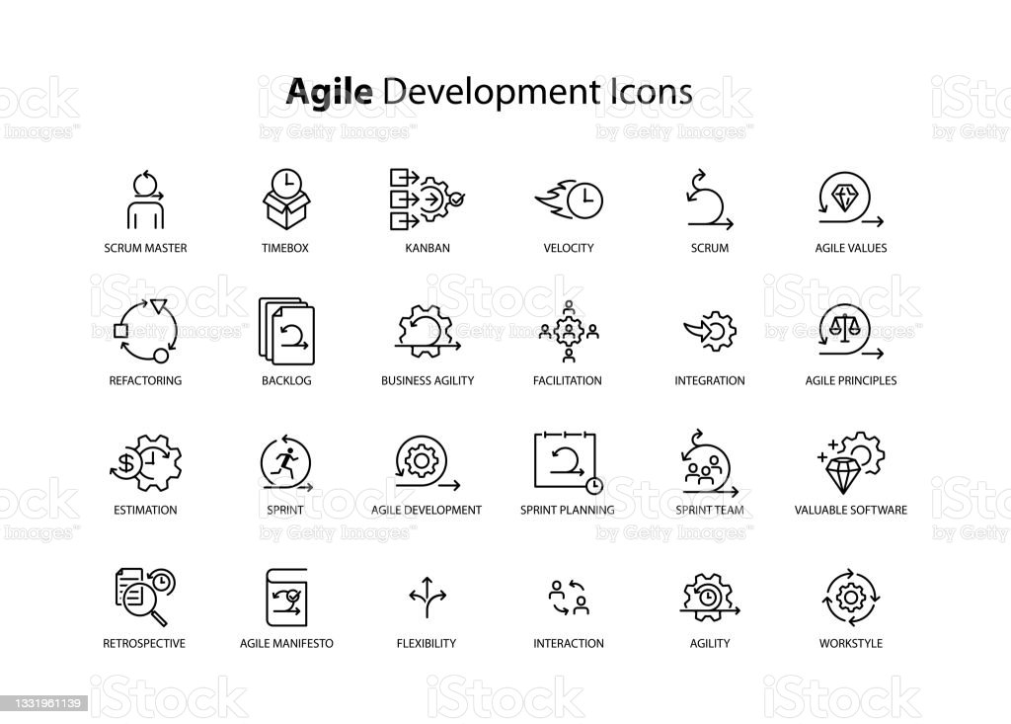
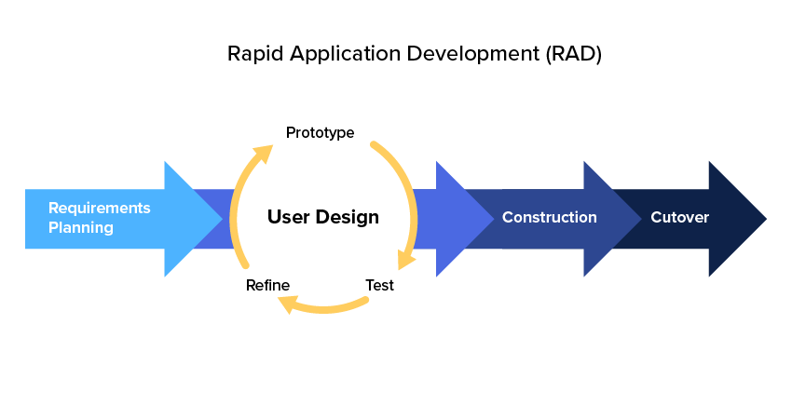
Unpacking Agile and RAD Through Case Study: "SmartWeather App"
Core Principles and Phases of Agile and RAD
- Agile: Iterative Development, Customer Collaboration, Responding to Change, and Delivering Functional Software.
- RAD: Business Modelling, Data Modelling, Process Modelling, Application Generation, Testing & Turnover.
Notes:
Our focus is to unpack Agile and RAD methodologies' core principles and phases. We will use a case study involving SmartWeather App, which utilised both methodologies during its development. Agile emphasises iterative development, customer collaboration, adaptability, and functionality. On the other hand, RAD is broken down into five core phases that we'll explore in-depth today.

Slide 32
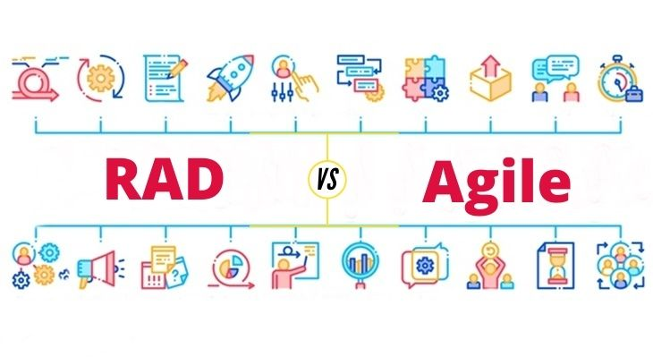
Apply Agile or RAD Methodology in a Simulated Small Team Project
Application in Small Team Projects
Real-world Utilisation of Agile and RAD in the SmartWeather App
- Agile: Used for front-end development, Scrum framework adopted.
- RAD: Used for back-end and database architecture.
- Outcome: Efficient and user-focused app development.
Notes:
In the case of SmartWeather App, Agile methodologies were applied primarily in front-end development using the Scrum framework. RAD, conversely, was heavily utilised in building the back-end and database architecture. The development team created an efficient, user-focused application by employing both methodologies where they best fit. This underscores the practical benefits of understanding when to apply Agile or RAD based on project requirements.

Slide 33
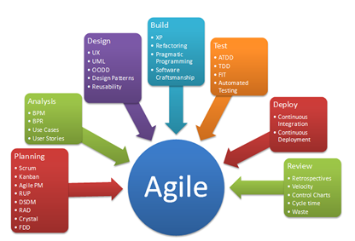
Document the Agile or RAD Process Utilised in the Small Team Project
Documentation of Processes
Importance and Methods of Documentation in Agile and RAD
- Agile: User stories, Sprint backlog, and Burndown charts.
- RAD: Data models, Prototypes, User feedback.
- Benefits: Accountability, Traceability, and Improved Communication.
Notes:
Lastly, we must touch upon the importance of documentation. In Agile, this often takes the form of user stories, sprint backlogs, and burndown charts. In RAD, it's crucial to document data models, prototypes, and user feedback. Proper documentation serves multiple purposes: accountability, traceability, and facilitating improved communication among team members. Documentation is not just a box to tick; it's an essential component of successful project management.

Slide 34
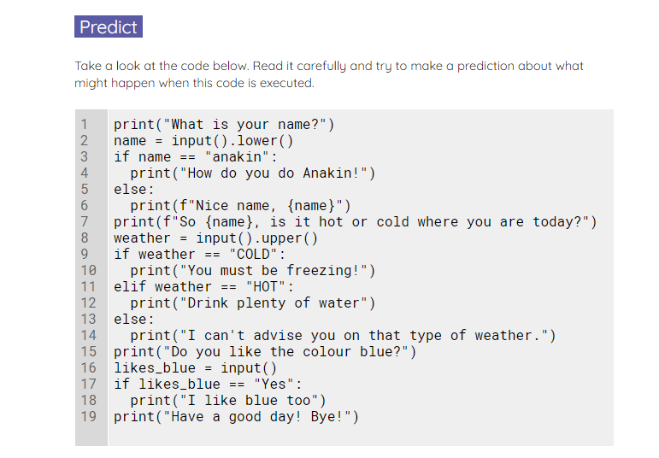
Chatterbot
Use the worksheet to investigate and modify a chatterbot.
Notes:
A2 Worksheet – Chatterbot

Slide 35
Multiple choice questions
Questions .
When this program is executed, what will be displayed on the screen, if the user enters Python at the prompt?
Wrong, Python is the best!
Hello Pythonista
Hello, Pythonista
Wrong, Python is the best!
There is an error in the program
print("Name the best programming language?")
language = input()
if language == "Python":
print("Hello Pythonista")
else:
print("Wrong, Python is the best!")
1
▹
2
3
4

Slide 36
Multiple choice questions
Questions .
When this program is executed, what will be displayed on the screen if the user enters 0 at the prompt?
0 is positive 0 is negative
0 is negative
0 is positive
There is an error in the program
print("Enter a number")
number = int(input())
if number > 0:
print(f"{number}, is positive")
else:
print(f"{number}, is negative")
1
2
▹
3
4

Slide 37
Multiple choice questions
Questions .
When this program is executed, what will be displayed on the screen?
small medium medium large
large
number = 13
if number < 10:
print("small")
elif number < 100:
print("medium")
elif number < 1000:
print("large")
1
▹
2
3
4

Slide 38
Objectives
Following this session, you should be able to:
Understand the Core Principles and Phases of Agile and RAD Methodologies
Apply Agile or RAD Methodology in a Simulated Small Team Project
Document the Agile or RAD Process Utilised in the Small Team Project

Slide 39

Questions?

Slide 40
Thank You

